Slide 1

Analyzing Cyclistic Trip Data for 2022 Annual Members and Casual Riders
Cyclistic is a bike rental service that provides bikes for both annual members and casual riders. The purpose of this presentation is to analyze the differences in how these two groups use Cyclistic bikes and provide recommendations for improving the service. The data used in this presentation is based on Cyclistic trip data for 2022.

Slide 2
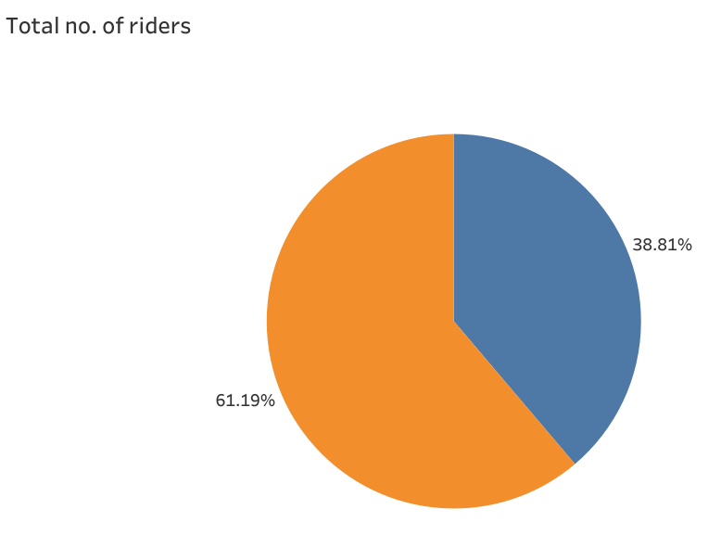
Annual vs Casual members Annual members: Subscribers who pay an annual fee for the unlimited bike rentals Casual members: Customers who pay a ride or purchase a day pass Here the data contains 61.19% Annual members and 39.81% Casual members

Slide 3
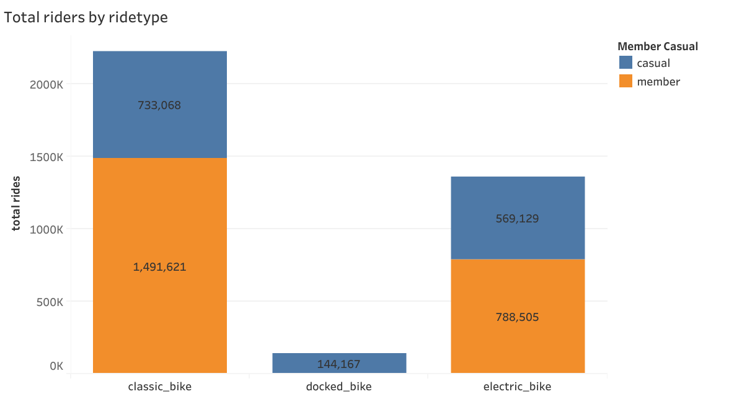
Different types of bikes using by customers
Members are mostly interest in classic and electric bikes
Docked bike are low popular than remaining

Slide 4
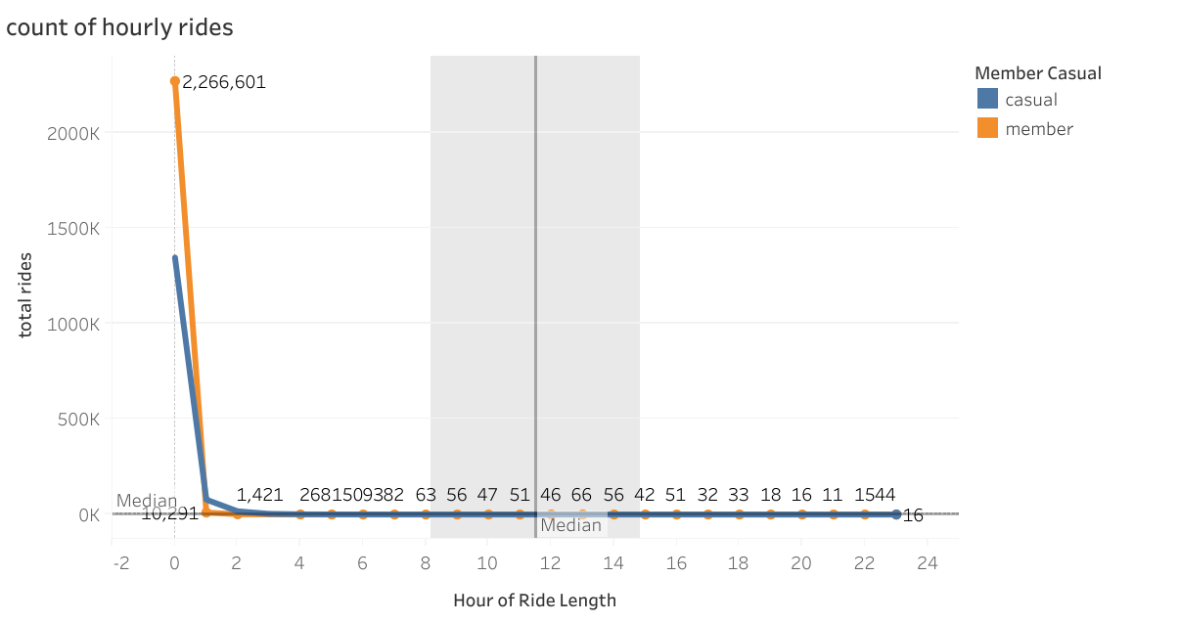
Ride length
The ride length of the customers is less than one hour(<1 hr)
The members are mostly giving ride >1 hr

Slide 5
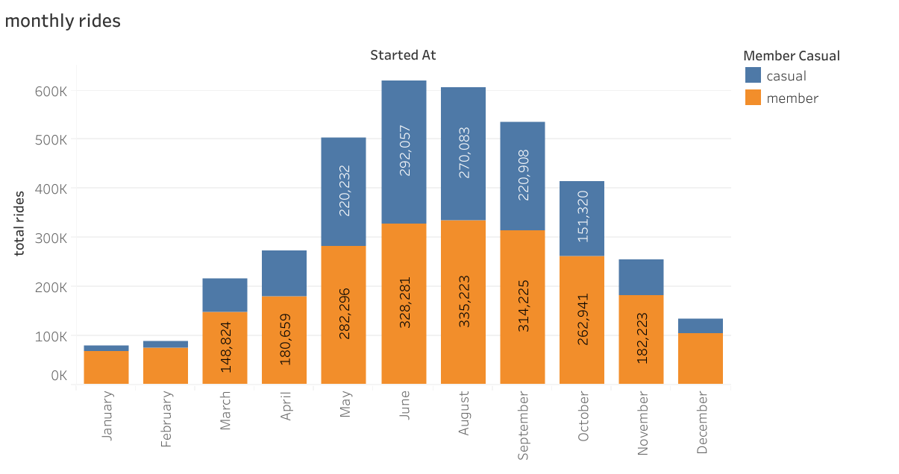
Trip frequency monthly
The month May to October has the highest number of rides
Casual members are mostly preferring these months
Subscribed members are same as casual but they actively riding every month May be because most of them are working proffessinols

Slide 6
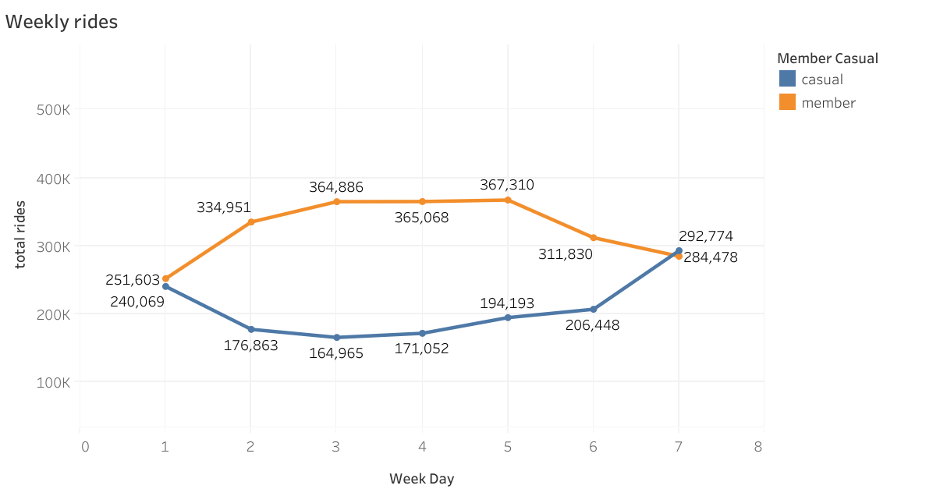
Trip purpose
Members are travelling highly on week days and lesser in weekend days ,so that members using for commute to work
Casual members riding on weekend than week days
This means we can say casual members are using cycles for mostly leisure or exercise

Slide 7
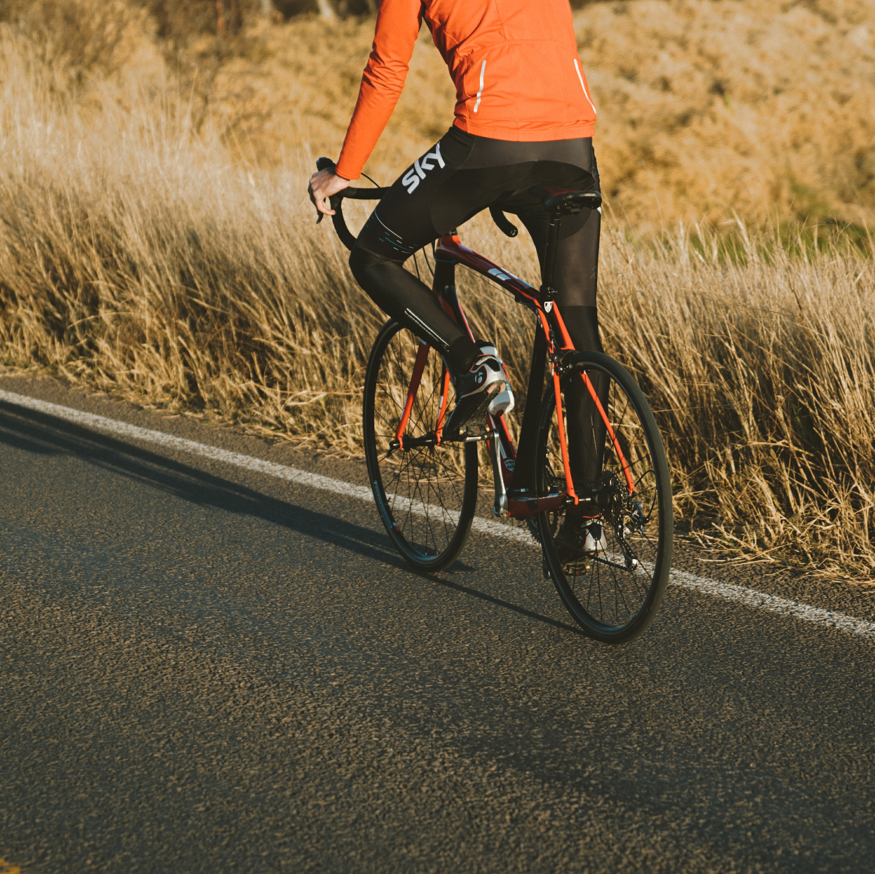
Popular locations
Casual members
1. Top starting locations: Streeter Dr &Grand ave, Dusable lake shore Dr & monroe st,Millennium park, Michen ave& oak st
2. Top ending locations: same as starting stations
Annual members :
Top starting locations: Kings bury st& kingi st,Clark st &Elm st,well st& concord ln
Top ending locations: same as starting locations
I will insert a tableau link to understand picture friendly cyclistic bike analysis-2022 | Tableau Public

Slide 8
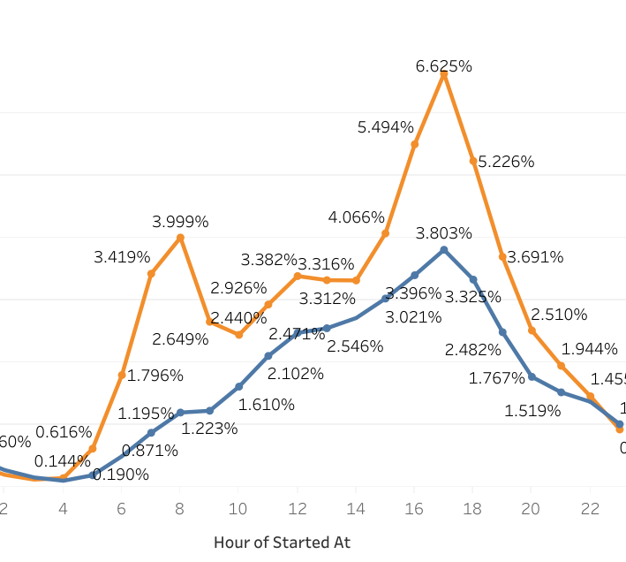
Ride starting time
Annual members : Starting time of annual members are at 6 AM which I the highest peak and again at 4-7 PM
Casual members: Starting time at 8 AM and increasing up to 6 PM

Slide 9
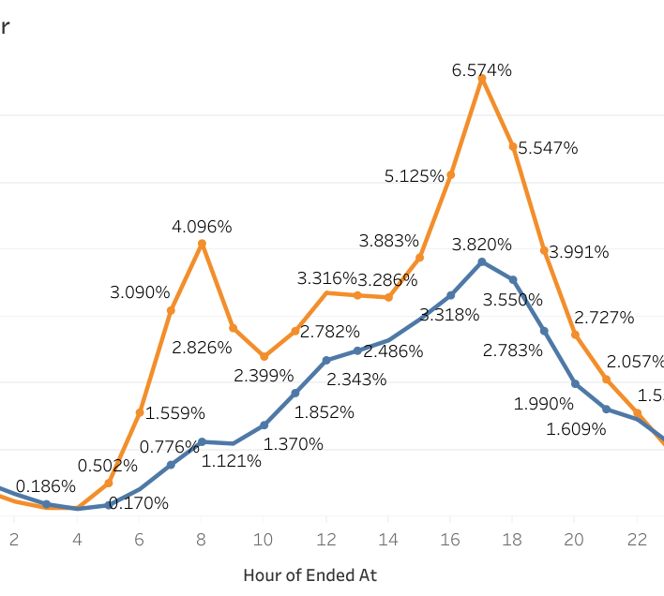
Ride ending time
Annual members: Ending time is same as starting time
Casual members: Ending is same as starting

Slide 10
Marketing strategies
Annual members: Target young professionals and students with promotions and incentives
Promotions :Discounted annual membership and referral bonus
Incentives : Exclusive access to new bikes and features
Casual members :Target tourists and occasional riders with seasonal promotions and discounts
Promotions :Summer discounts and holiday specials
Incentives: Free bike rentals for hotel guests and tour packages

Slide 11
Conclusion
Annual members have more trips compared to casual riders
Annual members use bikes more frequently for commuting while casual riders using for leisure and exercise.
The classic bicycle was the most famous among both types of users. However, it is to note that the docked bicycle is much more prevalent among casual riders.
Both users have the highest number of trips taken in the summer season from May to August. However annual members are consistently traveling the entire year, casual riders are frequently taking during summer
To improve Cyclistic’s bike rental services, Marketing strategies tailored to the different user groups.

Slide 12
Thank you

